Slide 1
Solar system

Slide 2
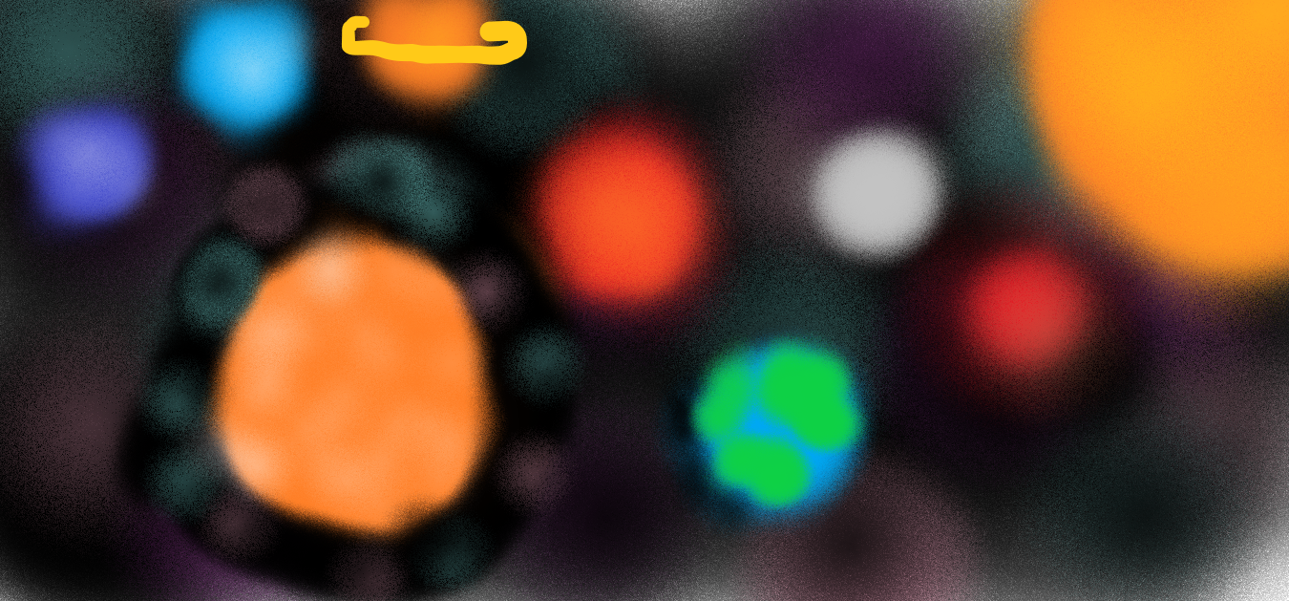

Slide 3
Planets in our solar system
Mercury - IT IS THE SMALLEST PLANET IN SOLAR SYSTEM.
Venus - IT IS THE BRIGHTEST OBJECT IN SOLAR SYSTEM AFTER THE MOON.
Earth - IT IS THE ONLY ASTRONOMICAL OBJEct known to harbour life.
Mars - it is the second smallest planet in the solar system.
Jupiter - it is the largest planet in the solar system.
Saturn - it is the second-largest planet in the solar system.
neptune – it is the furthest planet from the sun in the solar system.
Uranus - it has the third-largest planetary radius in the solar system

Slide 4
Interesting facts about THE SUN
Over one million earths could fit inside the sun.
The sun almost a perfect sphere.
it takes eight minutes for the light to reach earth from sun.
Temperature inside the sun can reach 15 million degree Celsius.
The sun is classified as a yellow ‘dwarf STAR’.
THE SUN IS TRAVELLING AT 220 KM PER SECOND.
THE DISTANCE BETWEEN EARTH AND SUN CHANGES.

